Slide 1
Deep Learning
Module1

Slide 2
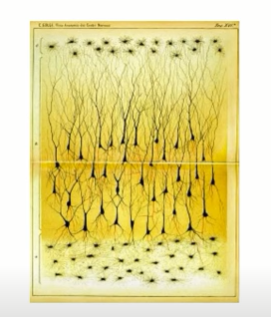
Neurons
Neurons (also called neurones or nerve cells) are the fundamental units of the brain and nervous system,
the cells responsible for receiving sensory input from the external world,
for sending motor commands to our muscles,
for transforming and relaying the electrical signals at every step in between.

Slide 3
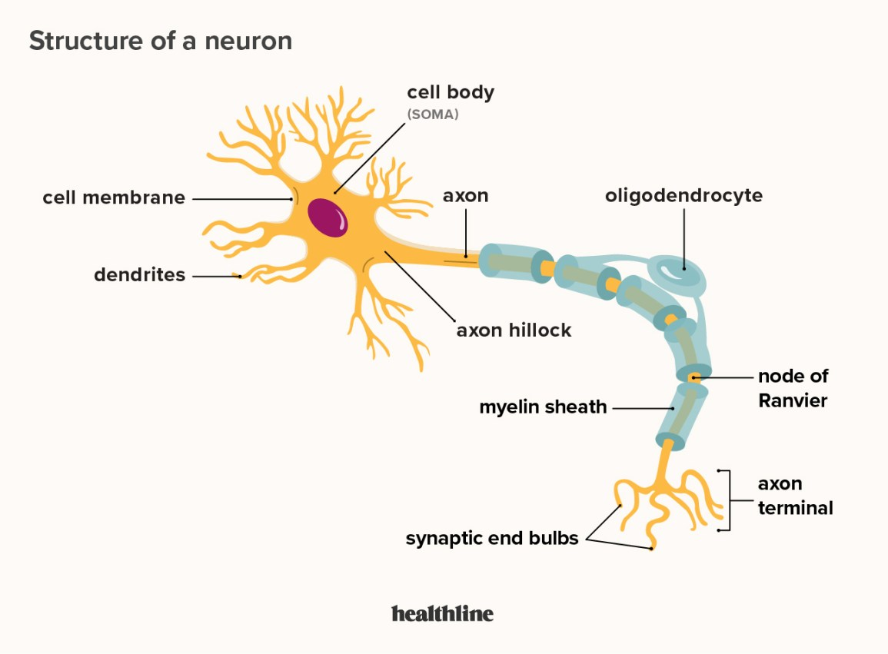

Slide 4
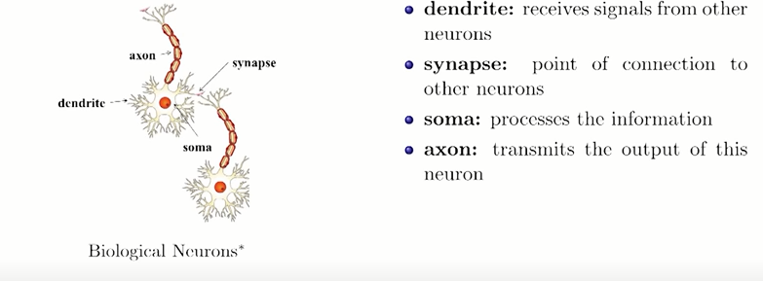
Parts of Neuron

Slide 5
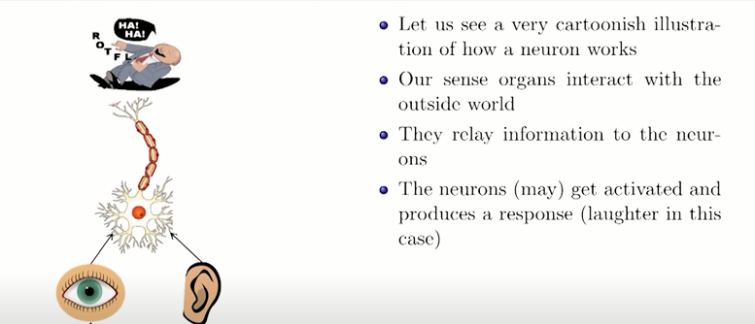
How Neuron Works

Slide 6
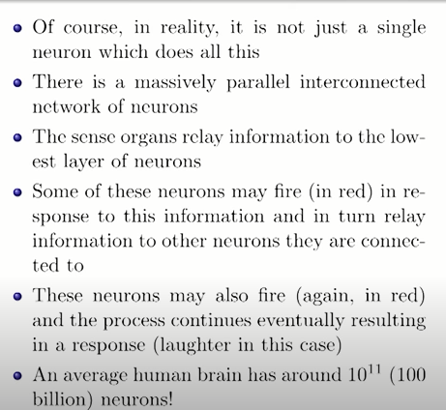

Slide 7
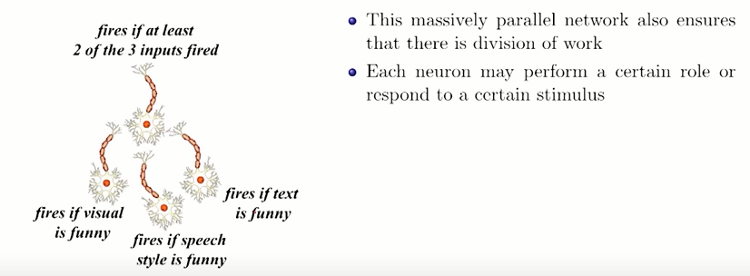

Slide 8
Neural Networks
reflects the behavior of human brain
allowing computer programs to recognize patterns and solve common problems in the fields of Artificial Intelligence(AI), Machine Learning (ML), Deep Learning (DL)
Also known as Artificial Neural Network (ANN) or Simulated Neural Network(SNN)
Subset of ML
Heart of DL algorithms

Slide 9
Structure of an ANN
Consist of several layers of nodes
Consist of
one input layer
One or more hidden layer
One output layer

Slide 10
Types of Neural Networks
Perceptron-Single Layer( Classical Perceptron, Perceptron)
Oldest neural network
Has a single neuron
Simplest form of neural network
Feed Forward NN(Multilayer Perceptron)
Convolutional NN

Slide 11
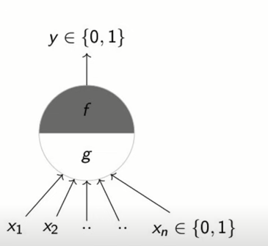
MP Neuron

Slide 12
MP Neuron
Take binary input from various sources and fed into a MP neuron then it come up with a binary decision

Slide 13
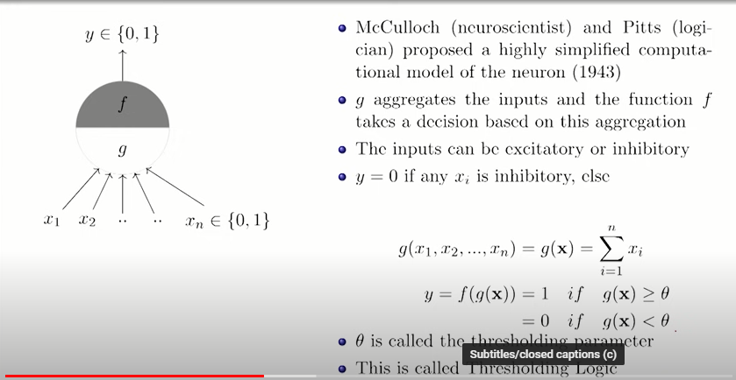
MP Neuron

Slide 14
Ɵ is the thresholding parameter which decides whether the neuron is going to fire or not

Slide 15
In an MP neuron it has 2 parts
First part Collect all inputs (similar to dendrites in biological neuron)
Second part decides what this aggregation is and based on that it will take a decision whether to fire or not
Output is also a Boolean value like the input
If output is zero the neuron doesn’t fire
If output is one the neuron fires.

Slide 16
Inputs can be of two types
Excitatory (actor=Matt Damon, director-Nolan, genre-thriller)
Inhibitory (leg injured/illness/not good mood etc)
If inhibitory input is ON the output will be zero
ie, the neuron is never gone to fire
Excitatory input will not alone cause the neuron to fire by its own, but it combine with all other input could cause the neuron to fire

Slide 17
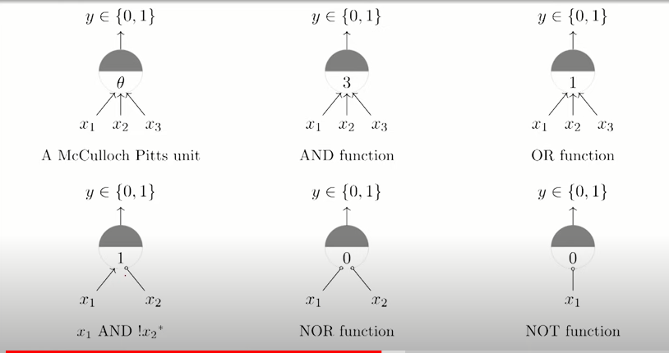
Implementation of Boolean Function using MP Neuron

Slide 18
When should an AND function fired??
When all inputs are 1
Value of threshold is 3
This is because an AND function gives an output 1 when all the inputs are 1
Here there are 3 inputs
So x1+x2+x3=3
AND GATE OPERATION FOR 2 INPUTS
x1 | x2 | x1 AND x2
0 | 0 | 0
0 | 1 | 0
1 | 0 | 0
1 | 1 | 1

Slide 19
When should an OR function fired??
When any of the input is 1
Value of threshold is 1
This is because an OR function gives an output 1 when any of the input is 1
Here there are 3 inputs
So x1+x2+x3=1
OR GATE OPERATION FOR 2 INPUTS
x1 | x2 | x1 OR x2
0 | 0 | 0
0 | 1 | 1
1 | 0 | 1
1 | 1 | 1

Slide 20
When should x1 AND !x2 get fired??
x2 is inhibitory input
If x2 is ON neuron will not be fired
Value of threshold will be 1
x1 | x2 | !x2 | X1 AND !x2
0 | 0 | 1 | 0
0 | 1 | 0 | 0
1 | 0 | 1 | 1
1 | 1 | 0 | 0

Slide 21
When should a NOR function fired??
NOR means NOT OR
Value of threshold is 0
This is because a NOR function gives an output 1 where an OR function gives zero (ie when both inputs are zero)
Here there are 2 inputs
So x1+x2=0
NOR OPERATION FOR 2 INPUTS
X1
x2
x1 OR x2
x1 | x2 | x1 OR x2 | x1 NOR x2
0 | 0 | 0 | 1
0 | 1 | 1 | 0
1 | 0 | 1 | 0
1 | 1 | 1 | 0

Slide 22
When should a NOT function get fired??
NOT operation has only one input
Threshold will be zero
Output becomes one when inputs become zero
Output becomes zero when input become one

Slide 23
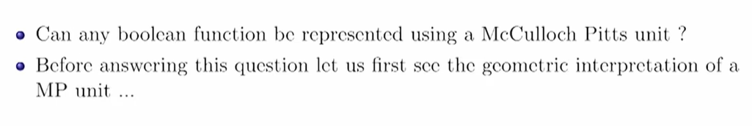
If you have a certain number of input variables and the function that you are trying to model (the decision that you are trying to make) is a Boolean function then you could represent it using MP neuron

Slide 24
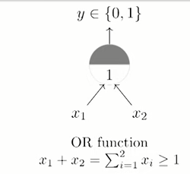
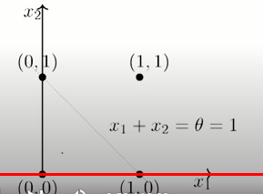
Consider the OR function
x1+x2=1 (by omitting >) then it will represent the equation of a line represent in a 2D plane

Slide 25
For all input for which the output is 1,they should lie on the line or on the positive side of the line.
For all input for which the output is 0,they should lie on the negative side of the line.

Slide 26
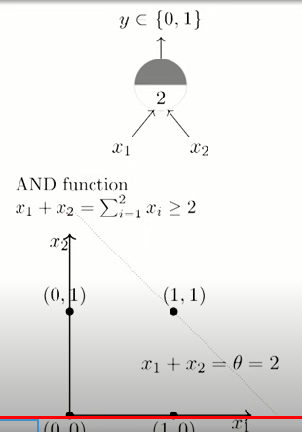
Consider the AND function
x1+x2=2 (by omitting >) then it will represent the equation of a line represent in a 2D plane. Here also there is a decision boundary ie passing through (0,2) and (2,0) by intersecting through the point (1,1)

Slide 27
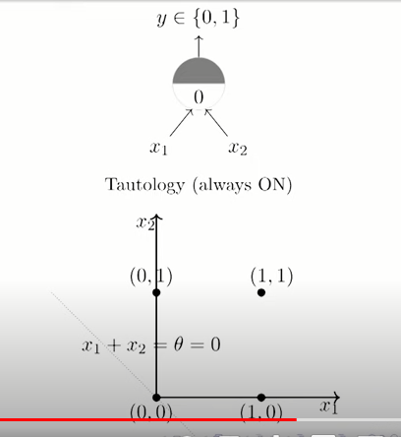
Consider the tautology function (output will always be 1)

Slide 28
The previous image is illustrating a simple perceptron model implementing a Tautology Function.
What is being shown?
Perceptron Model (Top Part)
Inputs: x1​ and x2​
Output: y∈{0,1}
The neuron is always ON (outputs 1), which is referred to as Tautology.
The threshold θ=0
Since this is a tautology function, no matter what the inputs x1​ and x2​ are (either 0 or 1), the output will always be 1
Geometric Interpretation (Bottom Part)
This is a plot of the possible input combinations in the 2D plane:
(0,0)
(0,1)
(1,0)
(1,1)
The line x1+x2=0 is shown.
This line essentially passes through the origin and is used to indicate the threshold boundary.
However, since θ=0, and any input will make the sum x1+x2​≥0, the output is always 1.
Tautology Function (Always ON) Meaning:
Regardless of the input values (x1,x2), the output will always be 1.
There is no way to provide any input that would result in output 0 because θ=0 is the least restrictive threshold.
This is why it's called "Tautology" — the perceptron is always ON.

Slide 29
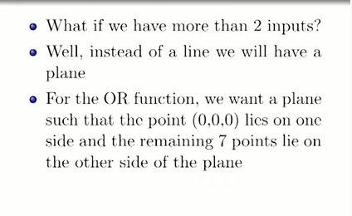
What if we have more than 2 inputs??

Slide 30
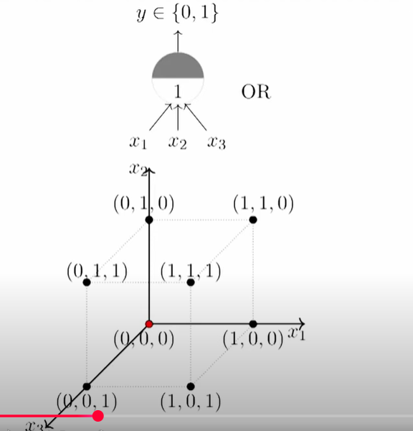

Slide 31
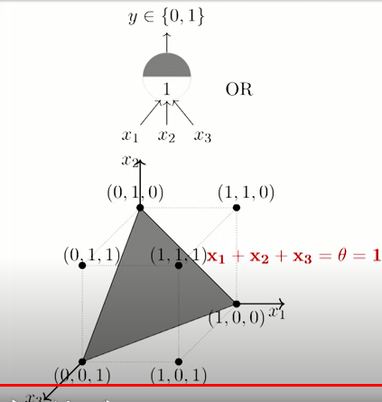

Slide 32
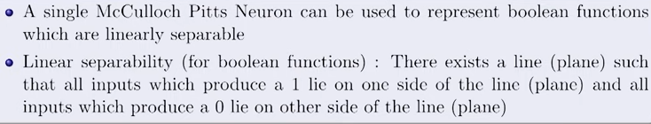

Slide 33
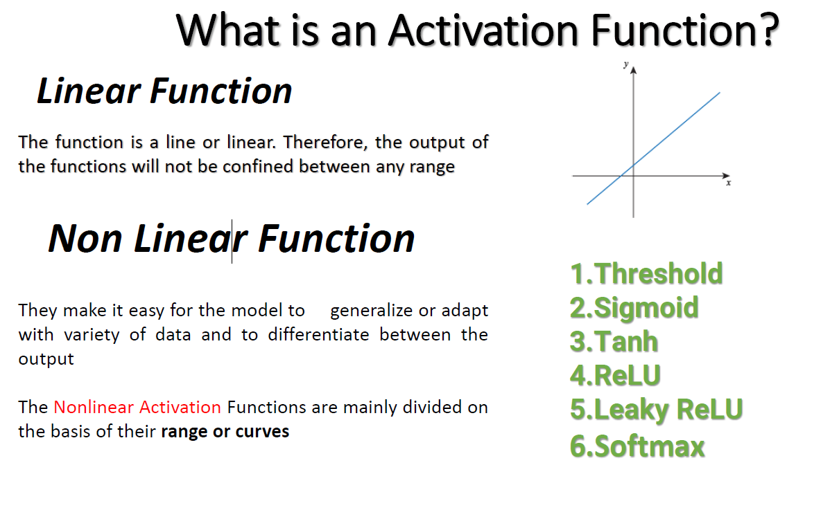

Slide 34
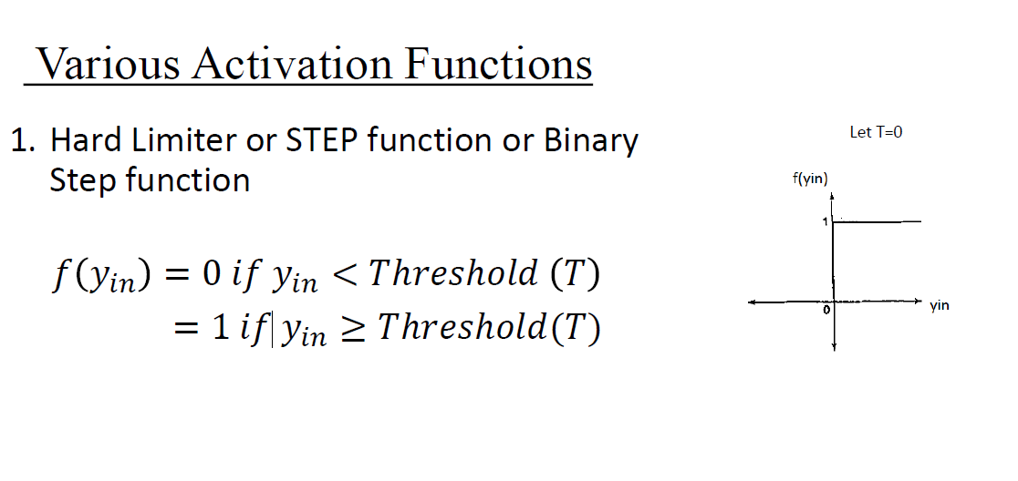

Slide 35
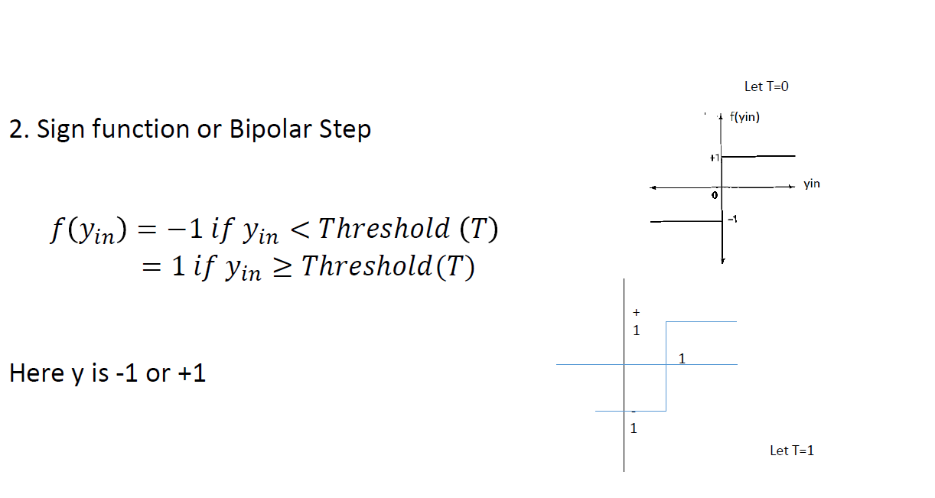

Slide 36
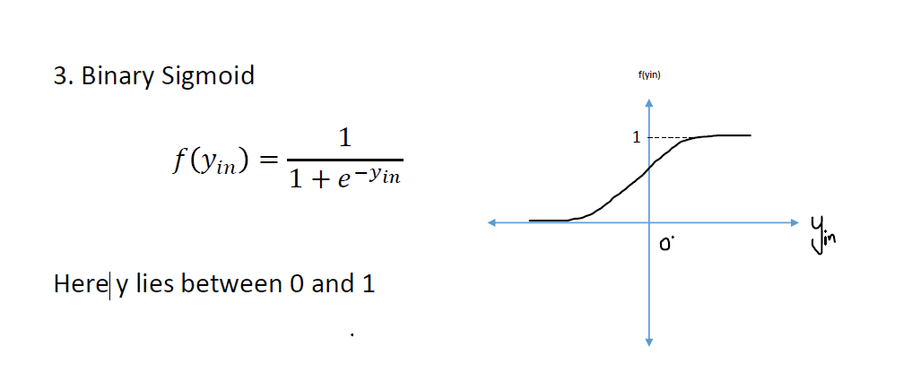

Slide 37
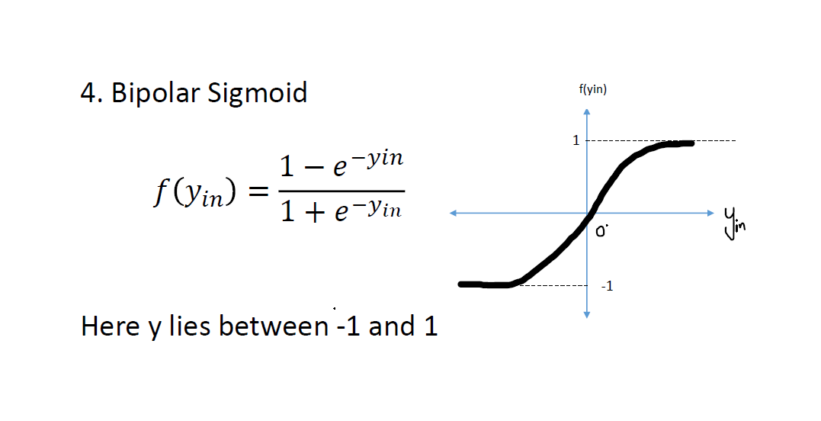

Slide 38
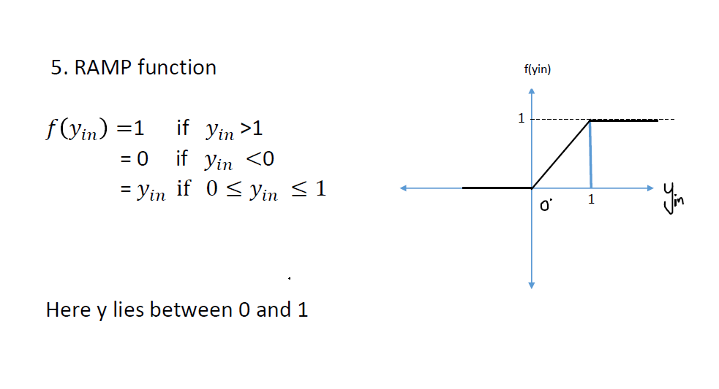

Slide 39
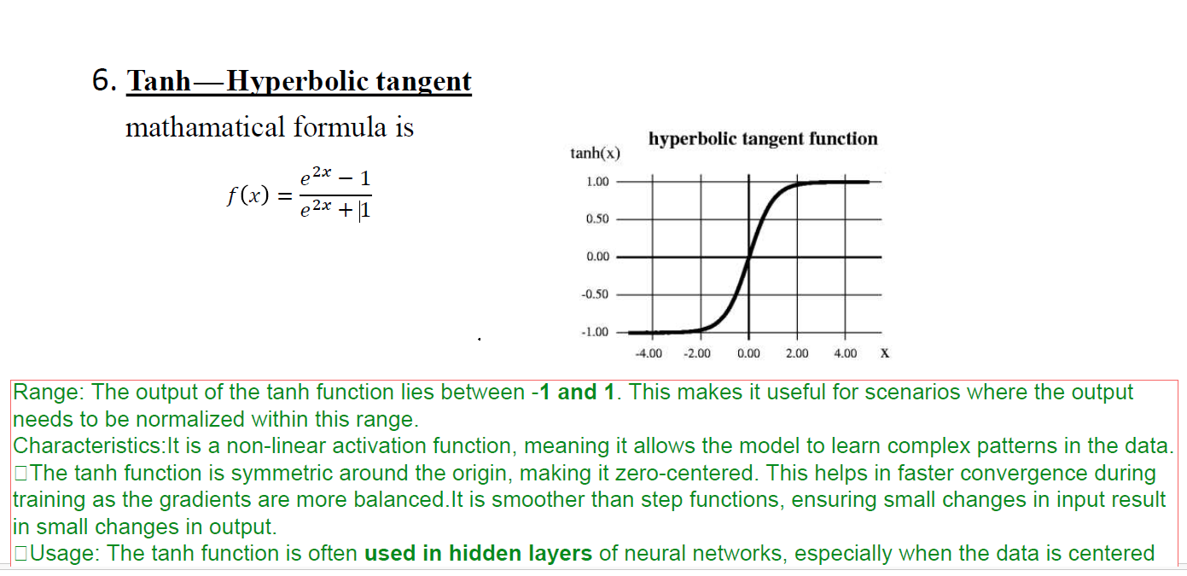

Slide 40
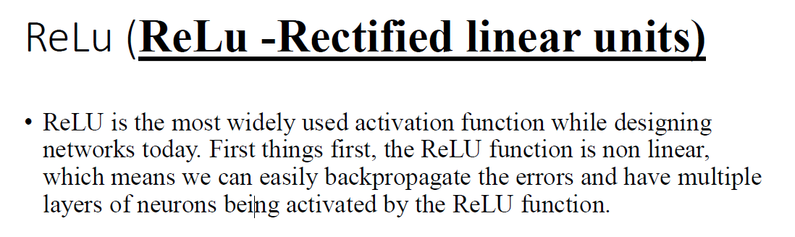
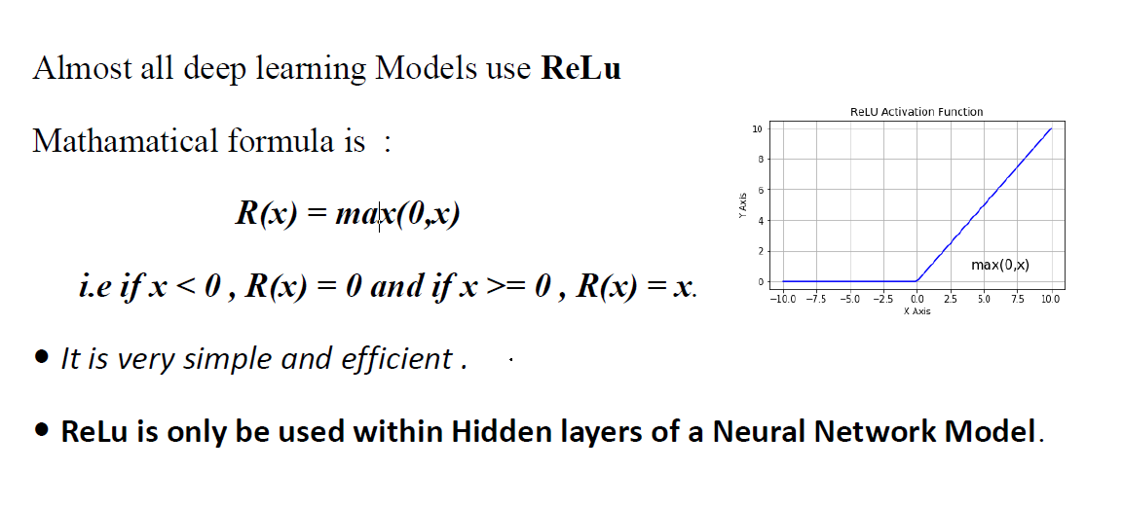

Slide 41
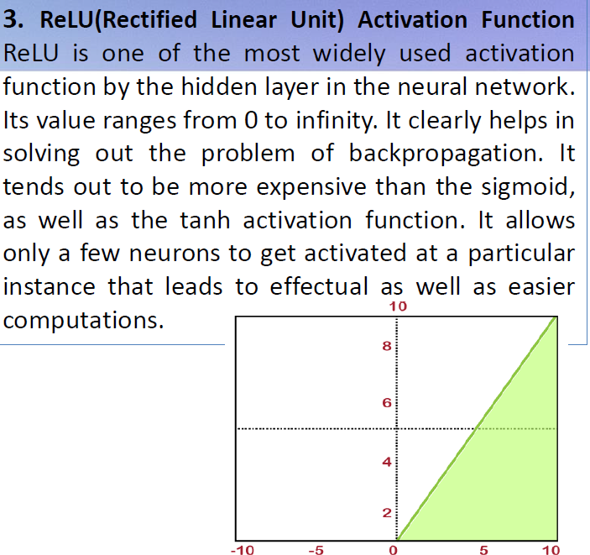

Slide 42
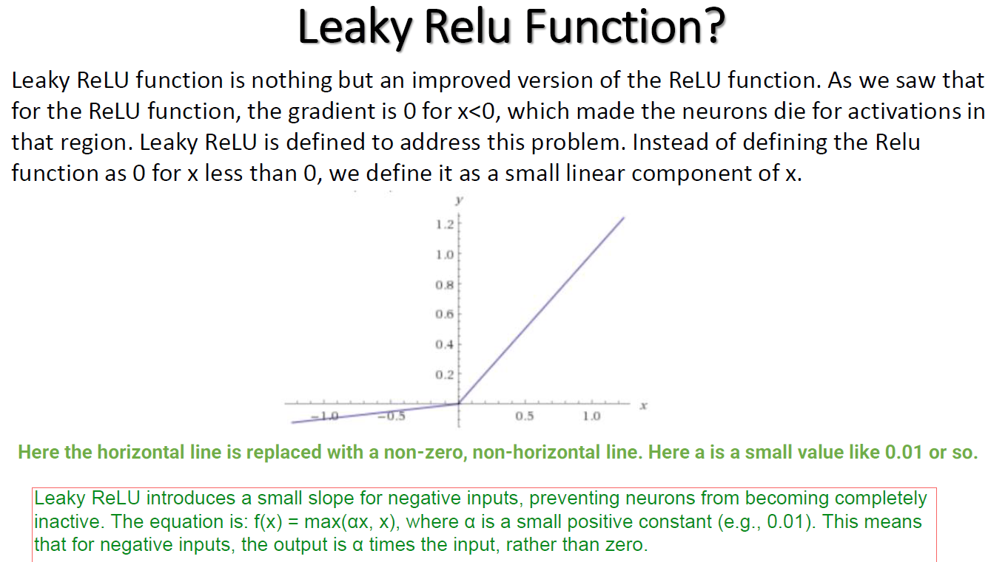

Slide 43
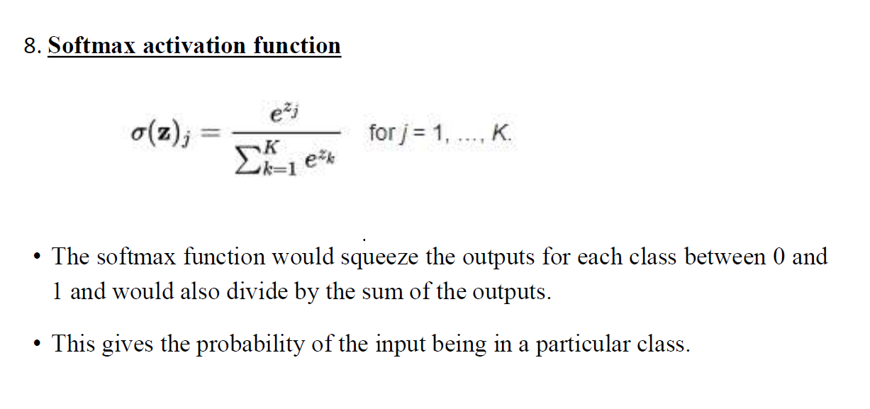

Slide 44
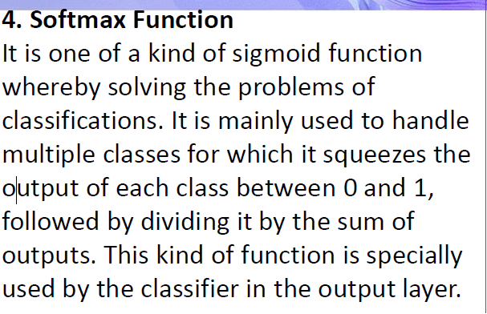

Slide 46
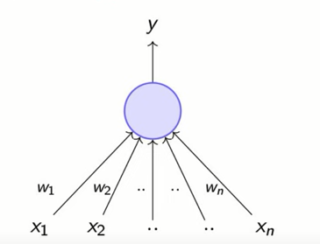
Perceptron

Slide 47
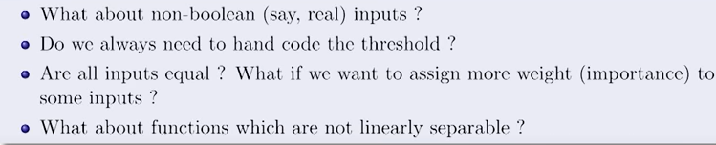
Factors lead to the idea of Perceptron

Slide 48
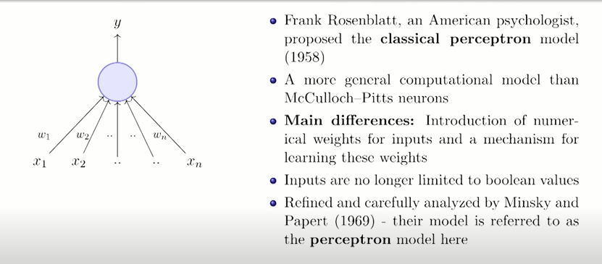
Classical Perceptron Model

Slide 49
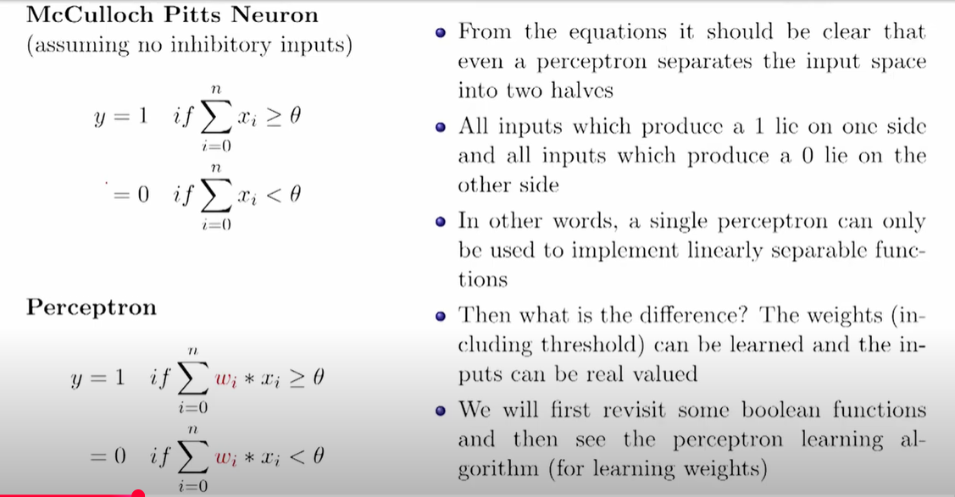

Slide 50
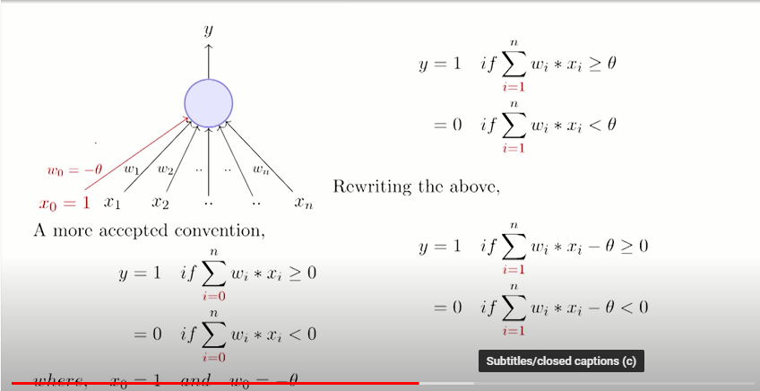

Slide 51
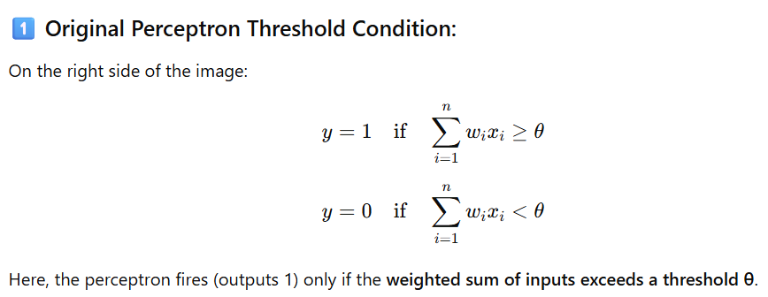
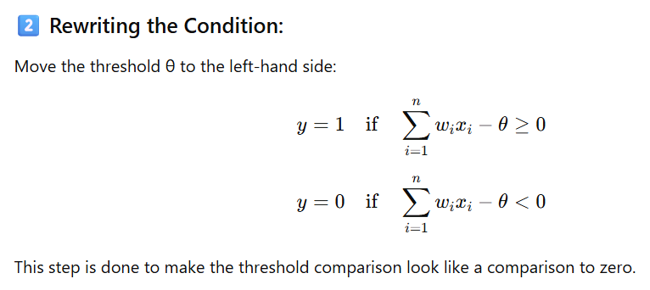

Slide 52
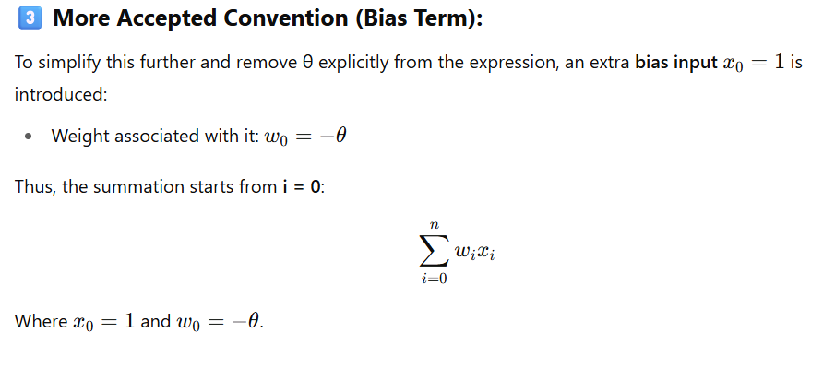
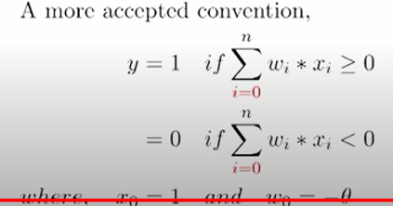
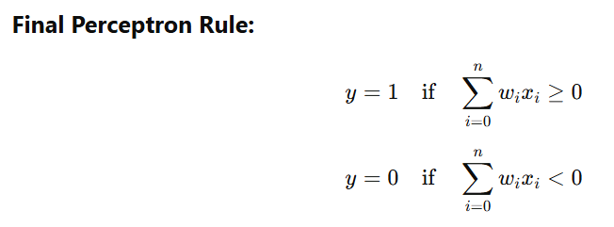

Slide 53
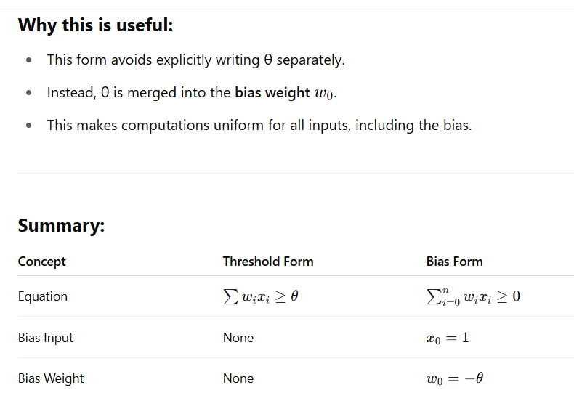

Slide 54
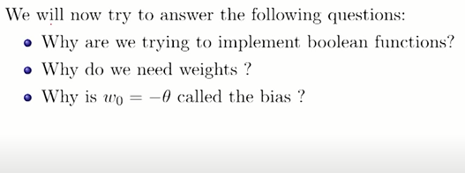

Slide 55
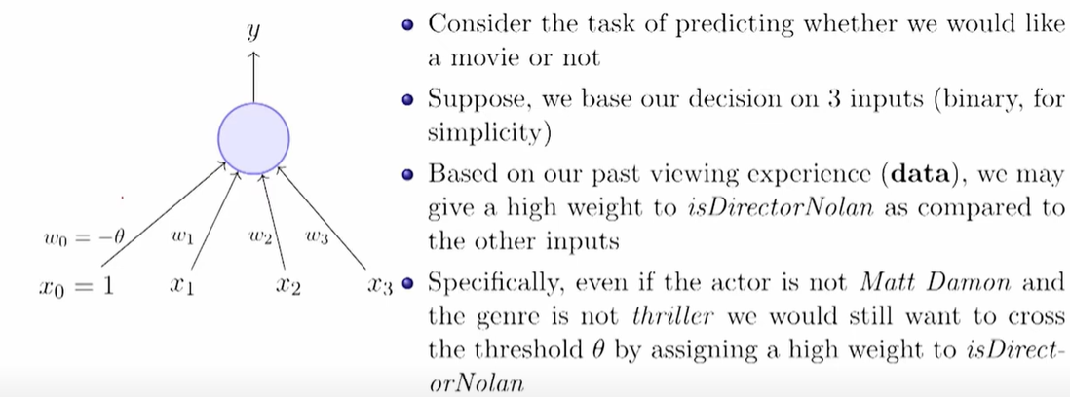

Slide 56
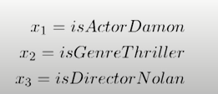

Slide 57
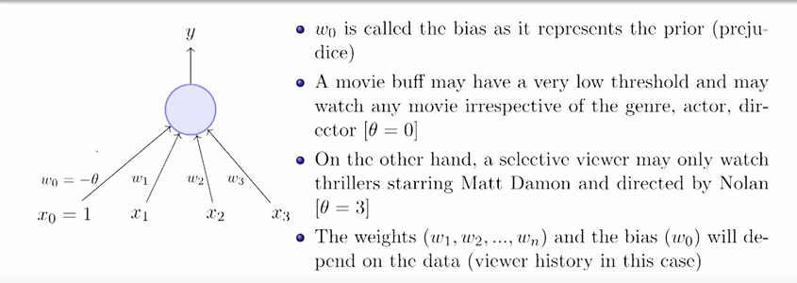

Slide 58
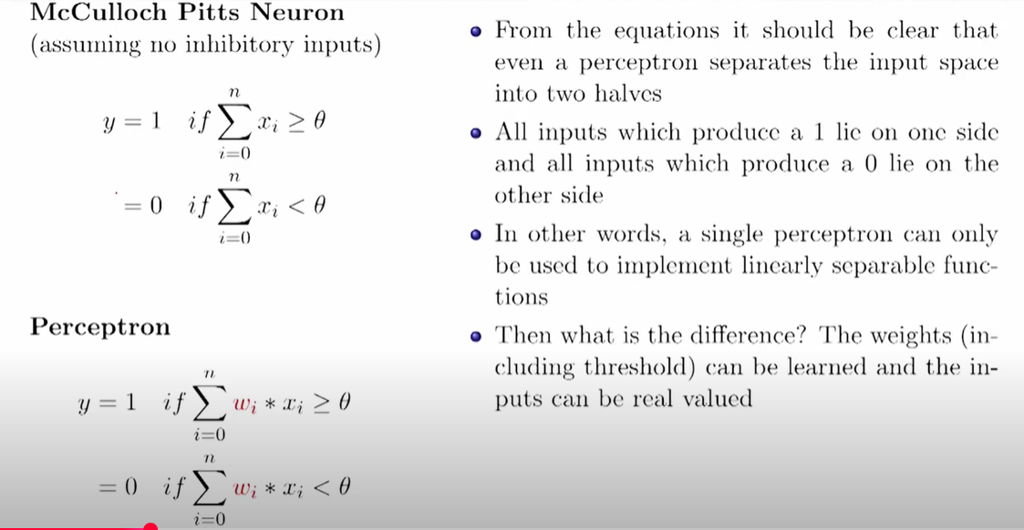

Slide 59
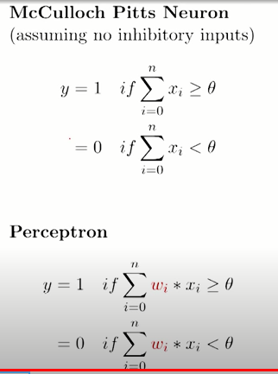
Difference between MP Neuron and Perceptron

Slide 60
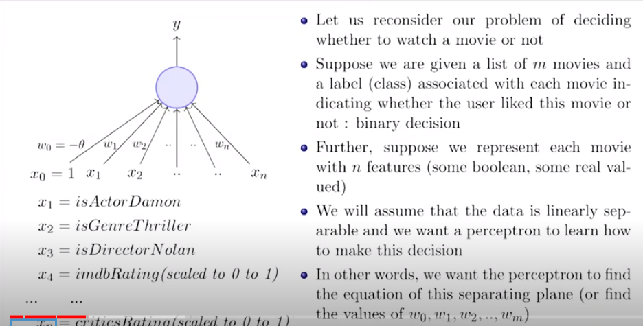

Slide 61
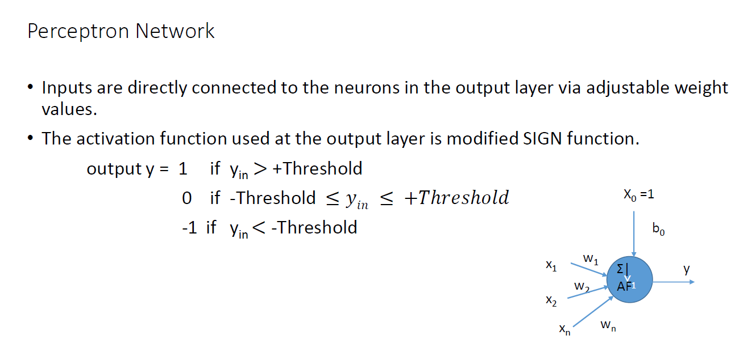

Slide 62


Slide 63
Sample algorithm for Perceptron learning (Refer slide Number 71 for actual perceptron algorithm.)

Slide 64


Slide 65


Slide 66


Slide 67

Linearly Separable
Non-Linearly Separable

Slide 68


Slide 69



Slide 70


Slide 71


Slide 72


Slide 73


Slide 74


Slide 75




Slide 76


Slide 77


Slide 78


Slide 79


Slide 80


Slide 81


Slide 82


Slide 83



Slide 84


Slide 85


Slide 86


Slide 87


Slide 88


Slide 89


Slide 90


Slide 91


Slide 92


Slide 93


Slide 94


Slide 95


Slide 96


Slide 97


Slide 98


Slide 99


Slide 100


Slide 101


Slide 102


Slide 103


Slide 104


Slide 105


Slide 106


Slide 107


Slide 108


Slide 109


Slide 110


Slide 111


Slide 112


Slide 113


Slide 114


Slide 115


Slide 116


Slide 117


Slide 118


Slide 119


Slide 120


Slide 121


Slide 122


Slide 123


Slide 124


Slide 125


Slide 126


Slide 127


Slide 128


Slide 129
END

